Slide 1
Applications Of Biotechnology
F. H. B. C. Diluki Silva
Introduction to Information Technology
SC1172

Slide 2
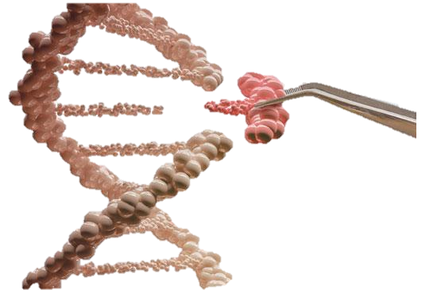
What is Biotechnology?
Biotechnology is referred as producing
or developing products by the use of
living systems for a better life for
humans and animals through a particular
process, without degrading the environment
This was first introduced by a Hungarian
agricultural engineer named Karl Ereky
(1878-1952) in 1919. He is regarded
as the “Father of Biotechnology”
Notes:
Biology means the study of living things. Biotechnology refers to the development of products using living systems like animal, plants, bacteria through a process. These production of new products are developed in a way that it will not degrade the environment. There are many subsections of biotechnology including agricultural, medical, molecular, marine and environment. Food biotechnology and many more

Slide 3
Applications of biotechnology
DNA fingerprinting
Transgenesis
Xenotransplantation
Stem cells and tissue engineering
Notes:
These are some applications of biotechnology, they are DNA fingerprinting, transgenesis, xenotransplantation and finally stem cells and tissue engineering. These applications are mainly based on animal biotechnology and medical biotechnology

Slide 4
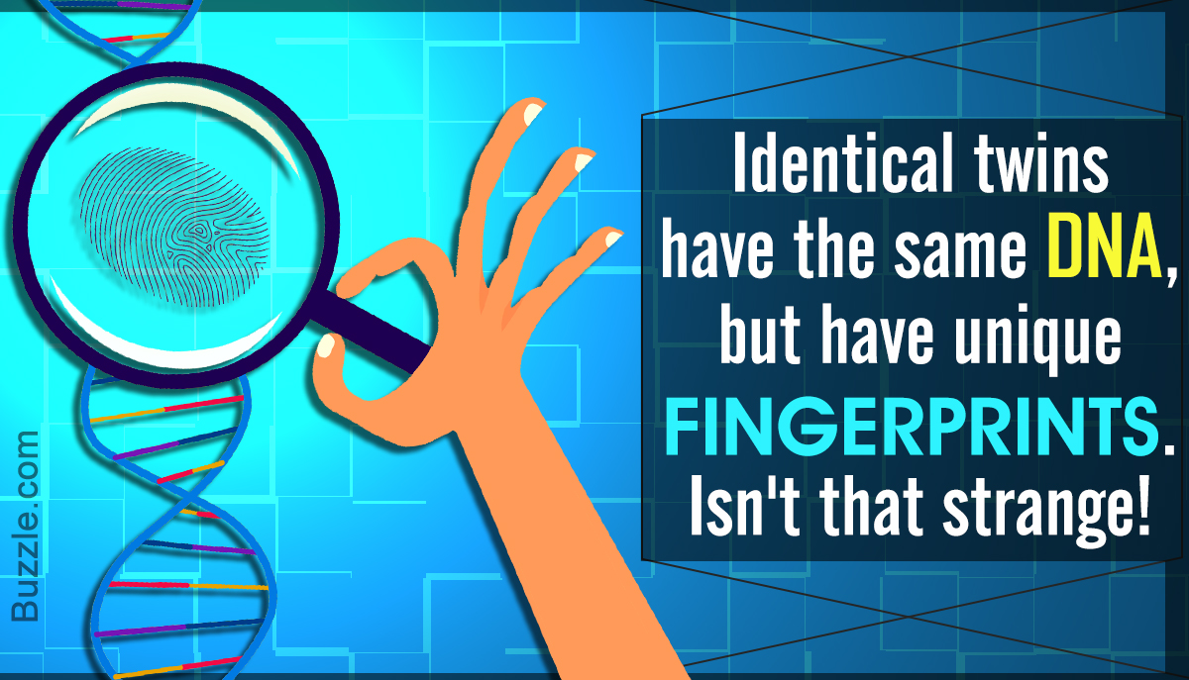
DNA Fingerprinting
DNA fingerprinting is a laboratory test that is used for the establishment of genetic makeups.
This is mainly used for:
Criminal Investigation
Identification of children
Identification of plants and bacteria
This is accurate almost 99.9% of the time and stored for
further investigation.
But sometimes these DNA samples can be destroyed during the process
which is regarded as a disadvantage

Slide 5
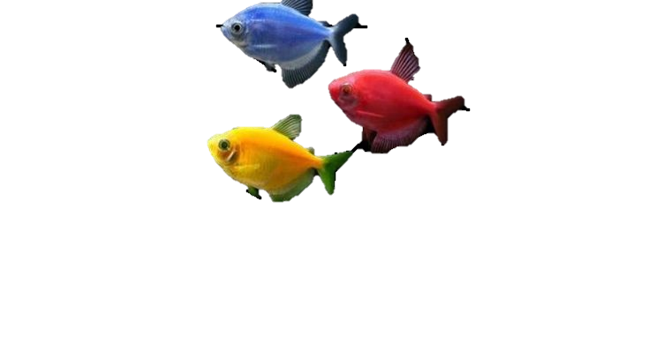
Transgenesis
Transgenesis is the artificial introduction of one or more DNA sequences
from one species to another
Transgenesis is used for:
Animals
Here the foreign DNA is injected to the fertilized egg
When the animal with these DNA is developed it can transmit
it to their offspring
These are known as transgenic animals
eg: glofish
Plants
Here the foreign DNA is introduced to variety of tissues
They are mainly used in crop fields, in pesticide reduction, etc..
These are known as transgenic plants
eg: Bt cotton, maize

Slide 6
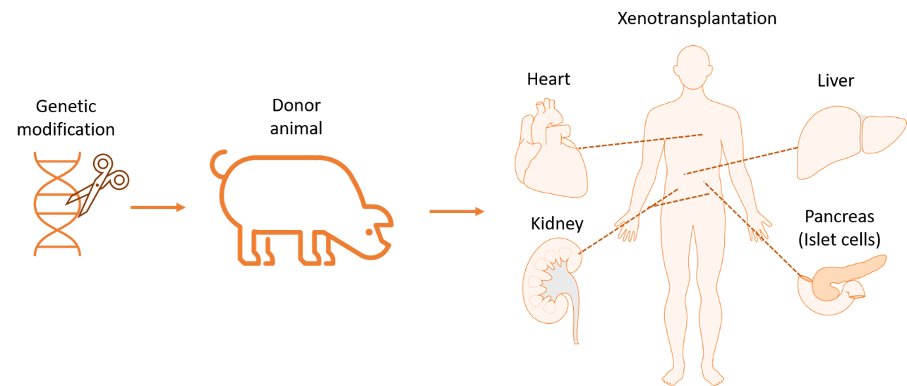
Xenotransplantation
Xenotransplantation is a genetically modified application of biotechnology
Here animal organs are been transplanted to humans which are compatible and not rejected by the human tissues
So using GM it can change the animal who donate the organs with then human genes
This way the animal organs can be accepted by the human body
There are some ethical issues when it comes to animal rights
Notes:
GM refers to as Genetically Modification. Ethical issues concerning xenotransplantation not only include animal rights but also the allocation of resources, and distributive justice. Due to public health risks, acceptance from public is also needed for this xenotransplants other than the patience acceptance

Slide 7
References
https://www.genome.gov/genetics-glossary/DNA-Fingerprinting#:~:text=DNA%20fingerprinting%20is%20a%20laboratory,evidence%20came%20from%20that%20suspect
https://www.genome.gov/genetics-glossary/Transgenic
https://www.pbs.org/wgbh/pages/frontline/shows/organfarm/regulators/clark.html

Slide 8
Thank You!

